Slide 1
e-Science Central
JBug
Paul Watson
Hugo Hiden
Simon Woodman
12th March 2013
Funders: RCUK Digital Economy Programme, Red Hat, Microsoft, EU, TSB

Slide 2
Digital
Research
Multi-Disciplinary Projects
Notes:
X-ray photoelectron spectroscopy

Slide 3
Cloud Computing
Opportunity to revolutionise IT (and Science)
Resources on-demand
Scalability
Collaboration

Slide 5
Video

Slide 6
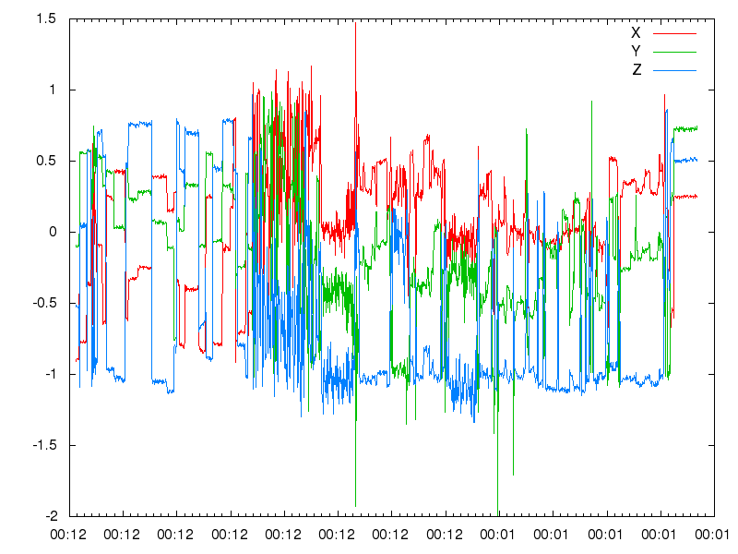
Analysis
Sleep
Activity
Stability
Grip
…
…
Clinician’s
Report
Information
for
Users
Methodology section for papers

Slide 7
Analysis
Sleep
Activity
Stability
Grip
…
…
Cloud
Clinician’s
Report
Information
for
Users
Methodology section for papers

Slide 8
Cloud Computing
Opportunity to revolutionise IT (and Science)
Scalable resources on-demand
Scalability
Collaboration
But Major Barriers
Building Cloud-based systems
Security
Governance

Slide 9
Cloud Computing
Opportunity to revolutionise IT (and Science)
Scalable resources on-demand
Scalability
Collaboration
But Major Barriers
Building Cloud-based systems
Security
Governance
Our work to overcome these barriers:

Slide 10
Building on Cloud Infrastructure
App 1
App n
....
Cloud Infrastructure:
Storage & Compute

Slide 11
Problems
Science requires apps to be:
scalable,
reliable,
secure
App 1
App n
....
This requires:
expertise
time,
money,
Cloud Infrastructure:
Storage & Compute

Slide 12
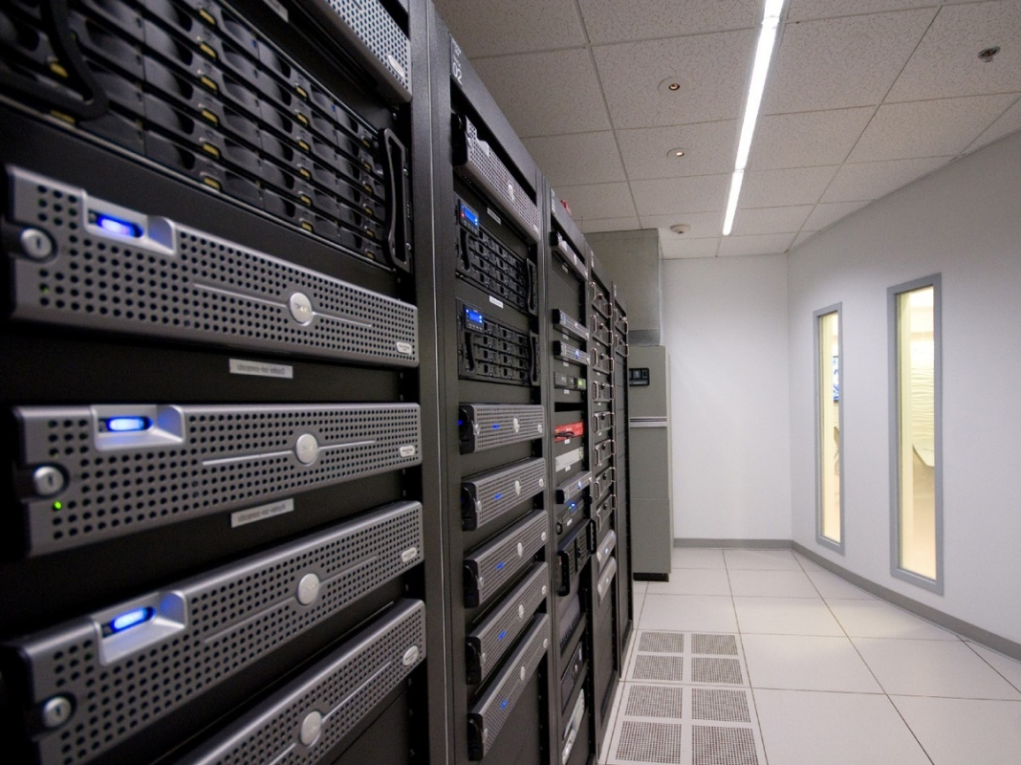

Slide 13
✗
App 1
App n
....
Cloud Platform
App 1
App n
....
Cloud Infrastructure:
Storage & Compute
Cloud Infrastructure: Storage & Compute

Slide 14
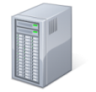
....
App
App
API
Security
Workflow Enactment
Social Networking
Provenance/
Audit
Analysis Services
Metadata
<expt>9127</expt>
<smiles>CHC3</smiles>
Cloud Infrastructure:
Amazon, Azure,
Private Clouds
Processing
Storage

Slide 15
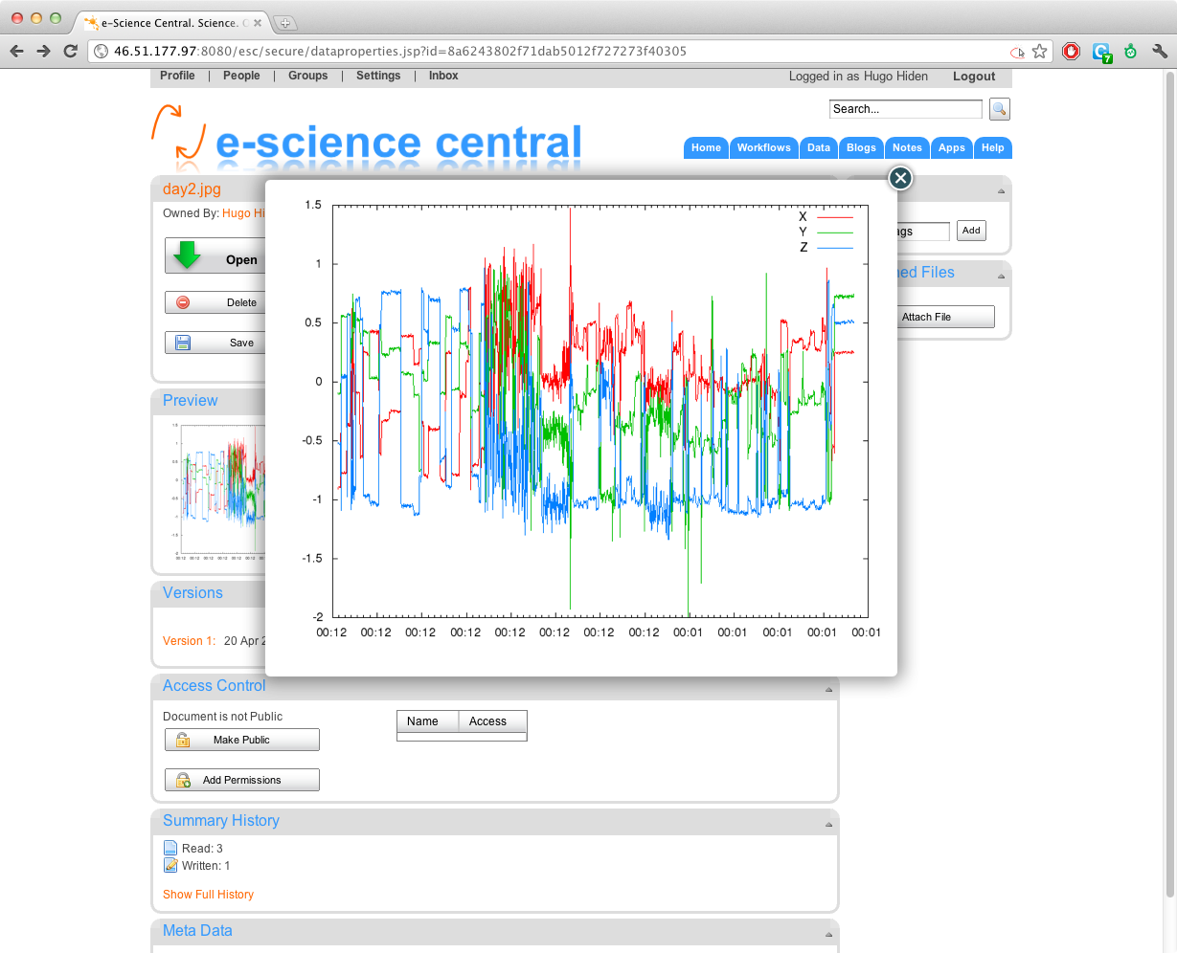

Slide 16
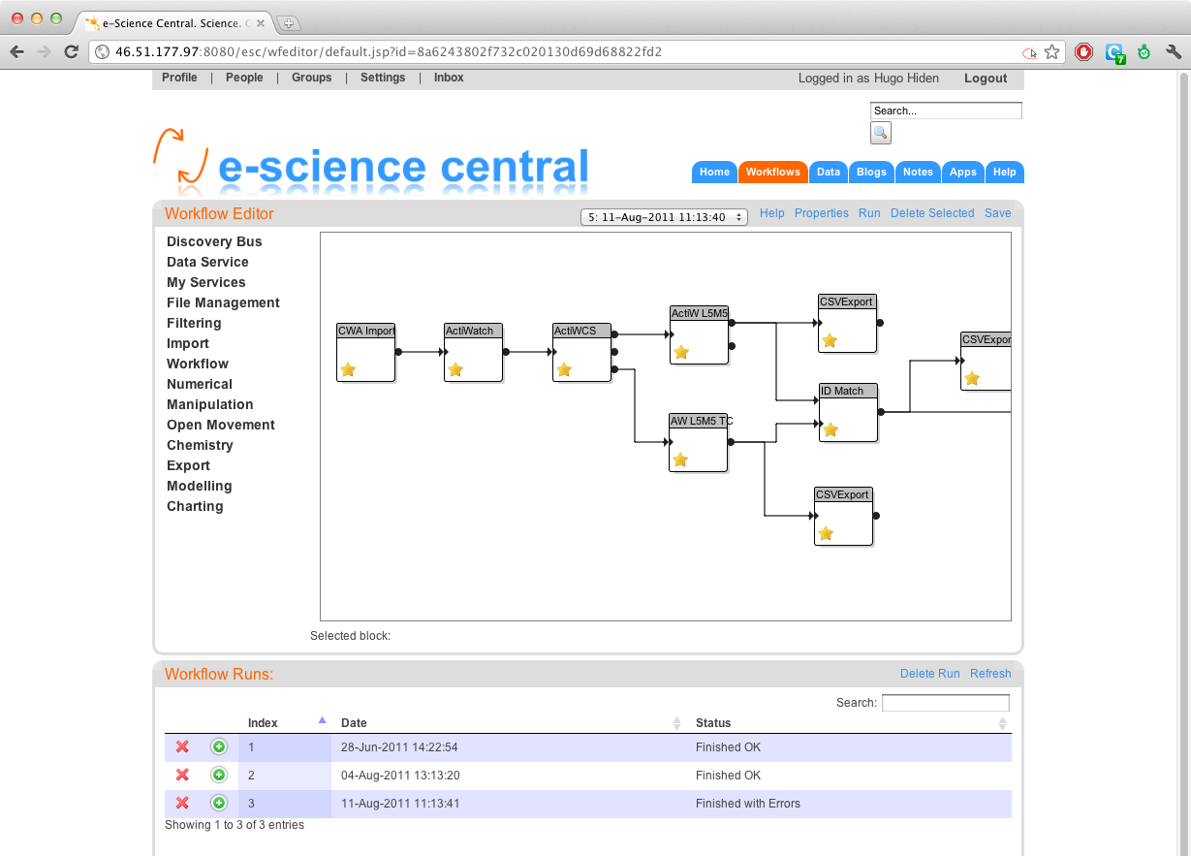

Slide 17
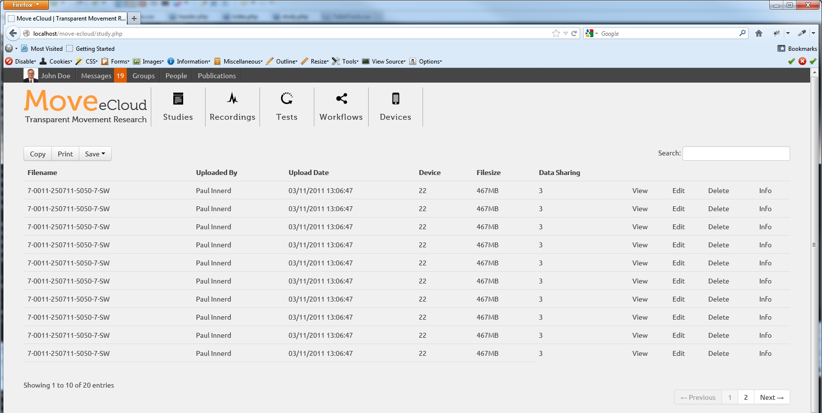

Slide 18
Cloud Barrier #2: Security
Patient Data
Accelerometer
Data
Smith
378456729
Results
Anonymize
Analyze
p = 30%
q = 27.4
r = 34
d₀
s₁
d₂
s₃
d₄

Slide 19
Cloud Federation
Organization
Internal IT
Internal Services
External Services
Public Cloud

Slide 20
Federated Cloud Options
Application
Private Cloud
Risk?
Public Cloud
Yes
No
Notes:
But… allocation at the level of a whole cloud limits the ability to exploit the scalability and cost benefits of public clouds. One piece of data in your application needs to be secure, and the whole application, even those parts that are not sensitive, must run on private cloud. But.. There is an alternative.

Slide 21
Problem
Can’t exploit multiple clouds in one workflow
Patient Data
Accelerometer
Data
Smith
378456729
Results
Anonymize
Analyze
p = 30%
q = 27.4
r = 34
d₀
s₁
d₂
s₃
d₄

Slide 22
Partitioning an Application
Patient Data
Heart-rate
Data
Smith
378456729
Results
Anonymize
Analyze
p = 30%
q = 27.4
r = 34
Private Cloud
Public Cloud

Slide 23
Method (P. Watson, “A Multi-Level Security Model for Partitioning Workflows over Federated Clouds” J. Cloud Computing, Vol. 1(1))
Assign Security Level to each Workflow Block
Check conforms to Bell-LaPadula
Assign Security Level to each Cloud
Determine possible allocations of blocks to clouds
Determine candidate workflow partitioning
Add inter-cloud data transfers
Filter
Apply Cost Model to Rank candidate solutions

Slide 24
1. Assign Security Level to each Workflow Block
Patient Data
Smith
378456729
Heart Rate Data
Results
Anonymize
Analyze
p = 30%
q = 27.4
r = 34
d₀
s₁
d₂
s₃
d₄
Location: 1 0 0 0 0
Clearance: 1 0

Slide 25
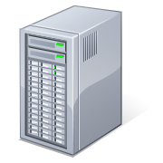
3. Assign Security Level to each Cloud
Private
Public
C₁
C₀
Location: 1 0

Slide 26
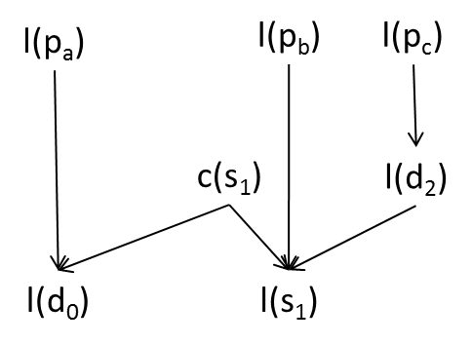
Extend Bell-LaPadula so a block cannot be deployed on a cloud with a lower security level
d₀
s₁
d₂
p_{a}
p_{b}
p_{c}

Slide 27
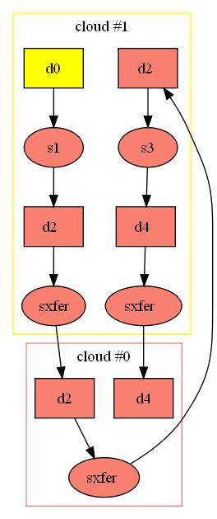
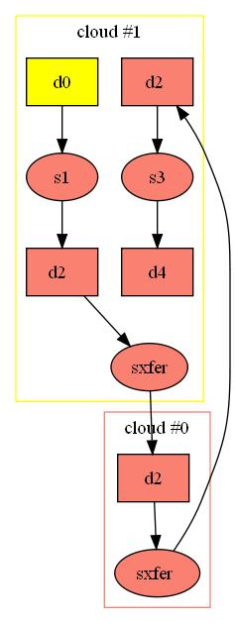
Valid Workflows

Slide 28
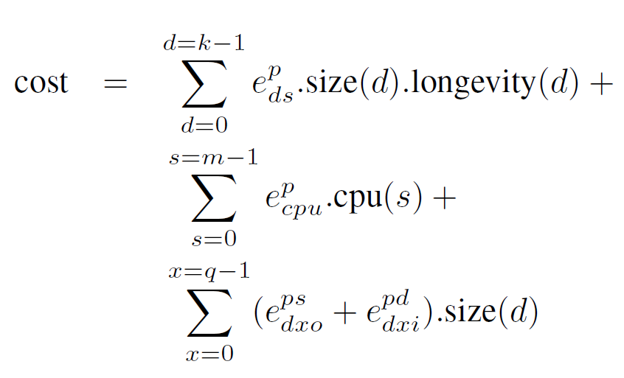
8. Apply Cost Model to Rank candidate solutions
Transfer Costs

Slide 29
Workflow Costs #1
3
4
6
5
2
1

Slide 30
Workflow Costs #2
1
2
5
6
3
4

Slide 31
Cloud Barrier #3: Loss of Governance
Barrier to the organisation, not to end-users
“I am very worried about controlling costs, IP and managing our data assets when so many of our staff are building their own cloud solutions”
Director of Major Company, 2012

Slide 32
Governance Policy:
Quotas
Sustainability
QoS:
Dependability
Security
Performance
Organisation
IT Resources

Slide 33
Organisation
IT Resources

Slide 34
Addressing Governance
Users access the cloud through e-Science Central, not directly
e-Science Central can enforce governance

Slide 35
Quotas
Cost
Security
Audit
Organisation
IT Resources

Slide 36
Summary
e-Science Central aims to realise potential of clouds
overcome barriers:
Scalability, Security, Audit, Governance
currently supporting £20M research projects
we are very interested in new users and collaborators
open-source (find us on source-forge)

