Slide 1
<number>
OC Systems
RTI for JBoss Operations Network

Slide 2
Agenda
OC Systems
Quick Introduction to Performance Engineering
What is it
Why is it important
RTI and JBoss Operations Network
What is RTI
How Does RTI Extend JBoss Operations Network
Architecture
Performance Eng Across the Lifecycle
Demo
Wrap-up

Slide 3
About OC Systems
Fairfax, VA
Founded 1983
Employee-owned
Software Tools
Services
PowerAda
Performance Engineering
Performance Testing
Test Automation
Software Audits – Memory, Tuning, Diagnostics

Slide 4
Clients

Slide 5
A Quick Intro to Performance Engineering

Slide 6
What is Performance Engineering?
“Performance engineering within systems engineering, encompasses the set of roles, skills, activities, practices, tools, and deliverables applied at every phase of the Systems Development Life Cycle which ensures that a solution will be designed, implemented, and operationally supported to meet the non-functional performance requirements defined for the solution.”
http://en.wikipedia.org/wiki/Performance_engineering
Key Take Away:
A discipline of System Engineering, applied at every phase of the Systems Development Life Cycle
Not just performance testing - set of roles, skills, activities, practices, tools, and deliverables.
Ensures that a solution will meet its non-functional performance requirements

Slide 7
Question…
What do these shoes have to do with software performance?

Slide 8
Case Study: Target (Sept 2011)
What: Target’s Missoni Product Launch driven by substantial Marketing campaigns generated traffic greater than typically seen on even black Friday.
Other Factors: A recent migration off Amazon EC2
Impact: Website was offline for over 15-hours, lost sales, unfulfilled orders, brand dissatisfaction. Steve Eastman, Target’s Online President quickly left to pursue “other opportunities”.

Slide 9
Case Study: Bank of America (Oct 2011)
What: Policy change - $5 monthly fee. Angry customers flocked to bankofamerica.com resulting in temporary unavailability errors from Friday into Monday.
Impact: Website unavailable to angry customers. Bank of America shares fell 30 cents, or 4.8 percent.

Slide 10
RTI and JBoss Operations Network

Slide 11
What is RTI?
RootCause Transaction Instrumentation (RTI) is an Application Performance Management (APM) tool providing performance monitoring, alerting and deep-dive capabilities.
Used to measure, diagnose and resolve complex software performance problems in distributed and composite environments
Enables Development, Quality Assurance and Operations to be pro-active about managing and improving application performance

Slide 12
How Does RTI Extend JBoss Operations Network?
RTI v3.3 integrates with JBoss Operations Network to extend its base performance capabilities including:
Business transaction discovery, monitoring and diagnostics
Lightweight transaction profiling
Deep-dive transaction tracing across JVMs, method-level diagnostics
Enhanced performance alerting, increases collaboration across operations, technical staff, and development.
A comprehensive integration of Metrics and Analysis - System resource, JBoss and JVM Metrics - to business transaction performance
Multiple Interfaces
Operational Dashboards, Alerting within Jboss Operations Network
Development Analysis of detailed metrics, diagnostics, traces and alerts using an Eclipse based Console.

Slide 13
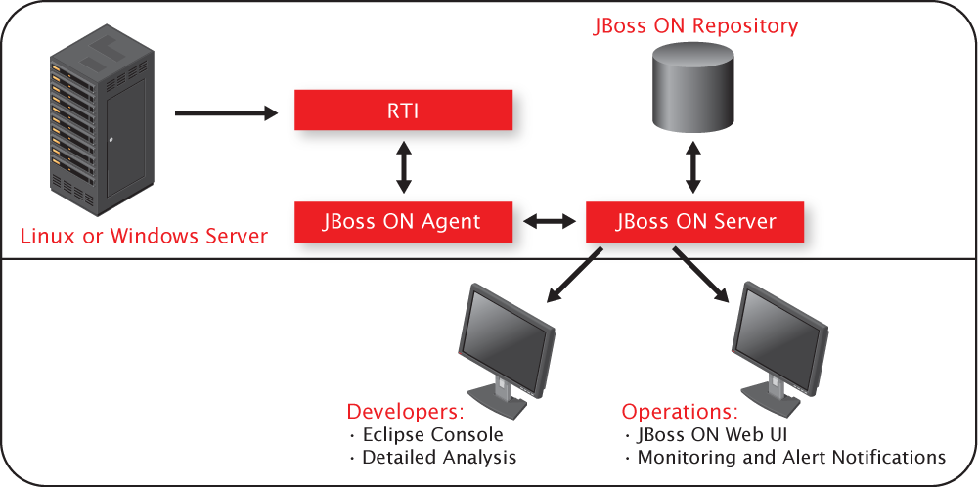
RTI and JBoss ON Architecture
RTI v3.3 leverages the JBoss ON plugin architecture to deliver comprehensive Application Performance Management seamlessly into the JBoss ON framework.

Slide 14
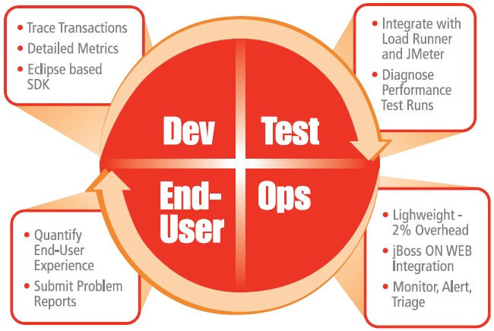
Lifecycle Approach to Performance

Slide 15
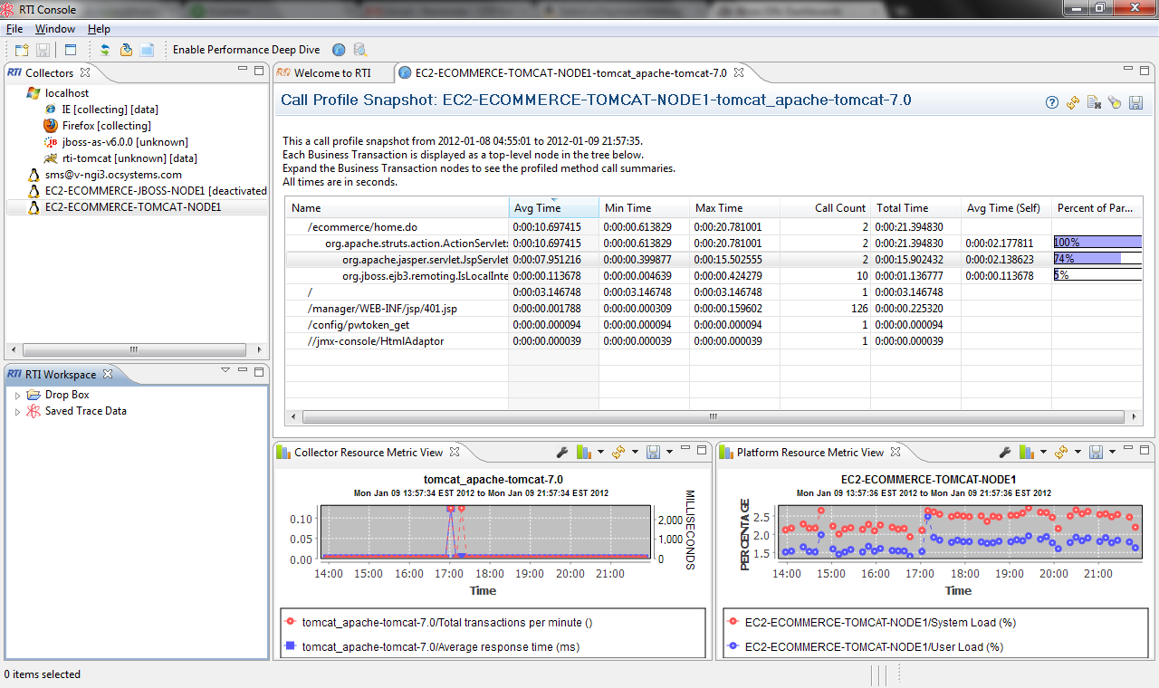
Developers and Technical
Eclipse based Client
Analyze Transaction Profiles
Deep-dive, trace transactions across JVMs and Platforms
Correlate JBoss ON Metrics - System resource, JBoss and JVM Metrics - to business transaction performance
Collaborate by analyzing, exporting and sharing data
Import Diagnostic Snapshots driven from Operational Alerts

Slide 16
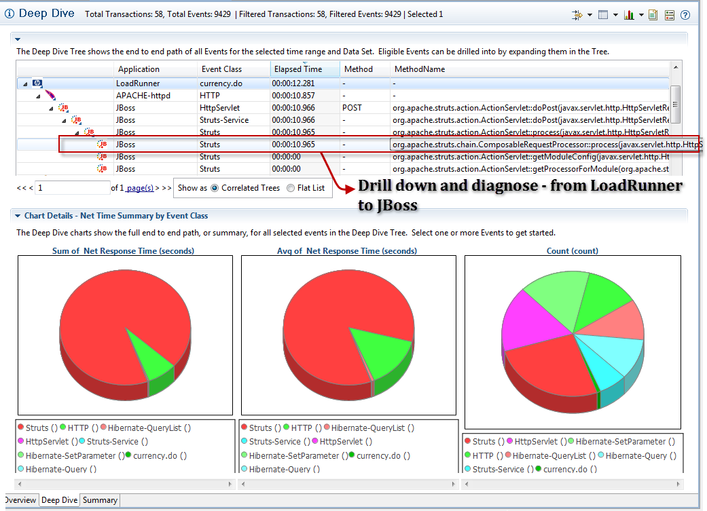
QA / Performance Testing
RTI integrates directly with LoadRunner, JMeter and soapUI:
Trace automated transactions from the load generator to the application method-level.
Isolate exact end-to-end traces by virtual user, load generator, or transaction.
Correlate backend application failures directly to the business process or transaction that they impact.
Measure and understand database calls on a per transaction basis, see every database call and the SQL or Hibernate HQL that was executed.

Slide 17
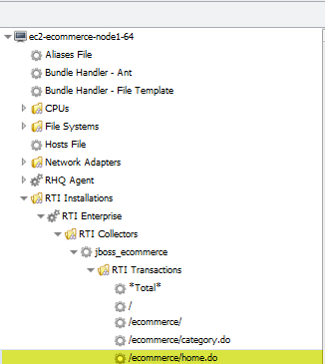
Operations
Automatically discover and monitor business transactions within the JBoss ON Web Interface
Low overhead transaction monitoring and lightweight production profiling
Define monitoring and alert on any code in your application – Legacy, COTS, POJO, JEE Framework
Respond to alerts by enabling diagnostic snapshots – diagnostic level traces of specific transactions.
Use JBoss ON as a single platform for all JBoss management, monitoring and diagnostics

Slide 18
Demo

Slide 19
Demo Environment
Amazon EC2 - VPC
Tomcat
JSP / Struts
Remote EJB
JBoss
EJB
MySQL
JMeter
JMeter
(virtual users)
RTI
RTI
JON Agent
JON Agent
JON
JON Server
PostgreSQL

Slide 20
Wrap-up

Slide 21
Supported Components

Slide 22
RTI Contact Information
Product Information: www.rtiperformance.com
Full featured and supported 31-day evaluation: http://www.rtiperformance.com/download
Questions: rti@ocsystems.com
Steve Sturtevant
Product Manager, OC Systems’ RTI
sms@ocsystems.com
703-359-8160

