Slide 2
Early (Major) Problems:
Winter 1997, high stakes problems encountered by those Enterprises that trusted the “Web Applications are ready!” promise.
CASE: The week before Christmas 1997 the web-facing OMS at www.amazon.com repeatedly crashed. Availability was severely impacted. Millions of dollars in potential revenue were lost. Credibility with customers damaged. Put simply, AMAZON.com cannot go down the week before Christmas!
An urgent, immediate solution was required to correct legacy application architectures so that they could reliably and performantly operate at “Internet scale”.
Enter Caching Technology!

Slide 3
What is at stake for Caching Solution Providers and their Customers?
Caching technology providers had a huge incentive to deliver a 100% sound and100% complete solution …. At Stake? The World Wide Web as a reliable and performant application platform.
NEEDED:
Accommodate application architects & developers with the capability to rapidly implement Caching technology.
Offload the database (ULTRA URGENT!)
Scale UP (How do I make the cache’s in-process heap scale?)
Scale OUT (How do I distribute my cache to multiple processes?)
Buffer against load variability

Slide 4
A Brief History of the Data Locality &
Latency Problem

Slide 5
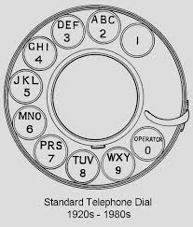
The very first data locality problem – Ma Bell and the FCC assignment of Area Codes. 1947.
NYC 212
LA 213
CHIC 312
…
MEMPHIS 901
RALEIGH 919

Slide 6
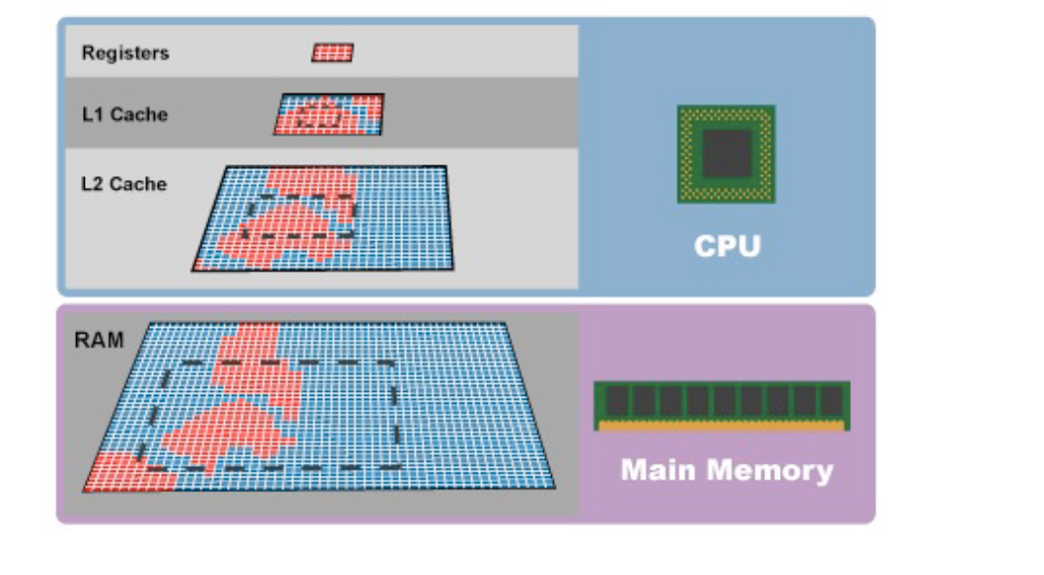
The Data Locality Problem
Big Decision: How much am I willing to “pay” to have my data as close as possible to processing resources?

Slide 7
Moving the data further away from the processing …
P1
P2
Local Unix Kernel (IPC Messages, Semaphores, Shared Memory)

Slide 8
A little further …
P1
P2
RDBMS
Local Client-Server

Slide 9
A little further … LAN Client Server
P1
P2
Client Host 1
Client Host 2
RDBMS
Data Server
7/9/2013

Slide 10
And further still … WAN Client Server
P1
P2
Internet
RDBMS
Public Data Source

Slide 11
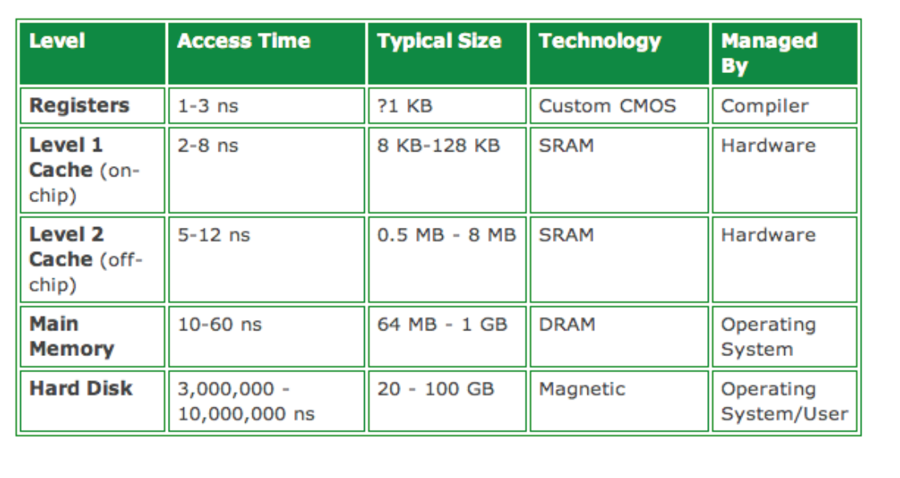
Latency Problem = Given that data is available, how fast can I access it for processing?
Forget networked client server!! All Low-Latency apps use highly optimized data feeds to bring the data “local”.

Slide 12
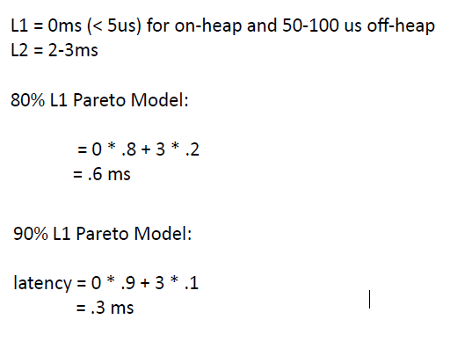
Latency Math ….
Architecting Latency Solutions: answering the question “How much am I willing to ‘pay’ to have my data as close as possible to processing resources?”
E(L) = $\sum_{i=1}^{N}{ t(l}$_{i} )P($l$_{i})

Slide 13
Latency Physics ….
2,000 PhD Physicists now working on Wall St.
U.S. Colleges and Universities cannot produce nearly enough Physics PhDs to meet Wall St. demand
Many of these PhD Physicists are from former Soviet-Bloc countries
COLD-WAR priority work = building defenses that could stop Western advances in Stealth technology (largely un-successful)
POST COLD-WAR priority work = designing low-latency, high-frequency Capital Markets trading algorithms (very successful!)

Slide 14
Latency Physics ….
Famous LL/HF Capital Markets Trading Algorithms =
“Cherokee Nation”
“Marco Polo”
“Boston Shuffler”
“Frog Pond”
“Carnival”
“Twilight”

Slide 15
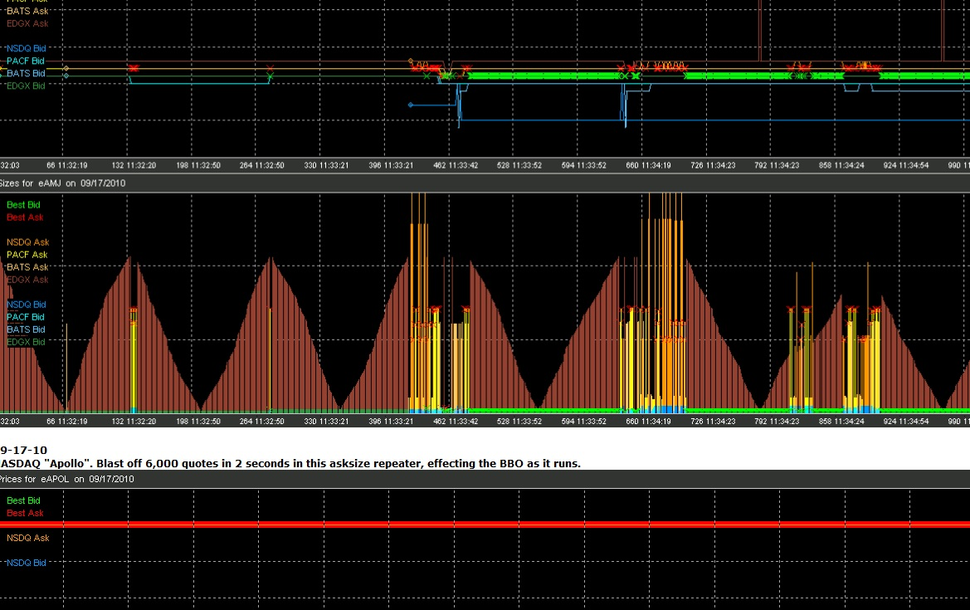
Why these names, e.g. Why “Cherokee Nation”?

Slide 16
Latency Physics ….
Bottom Line :
Great Latency iff Great Location
FAMOUS CASE STUDY = NYC Carrier Hotel
Algorithms “check in” but … They don’t “check out” ! (details to follow)
http://www.carrierhotels.com/news/September2001/60hudson.shtml

Slide 17
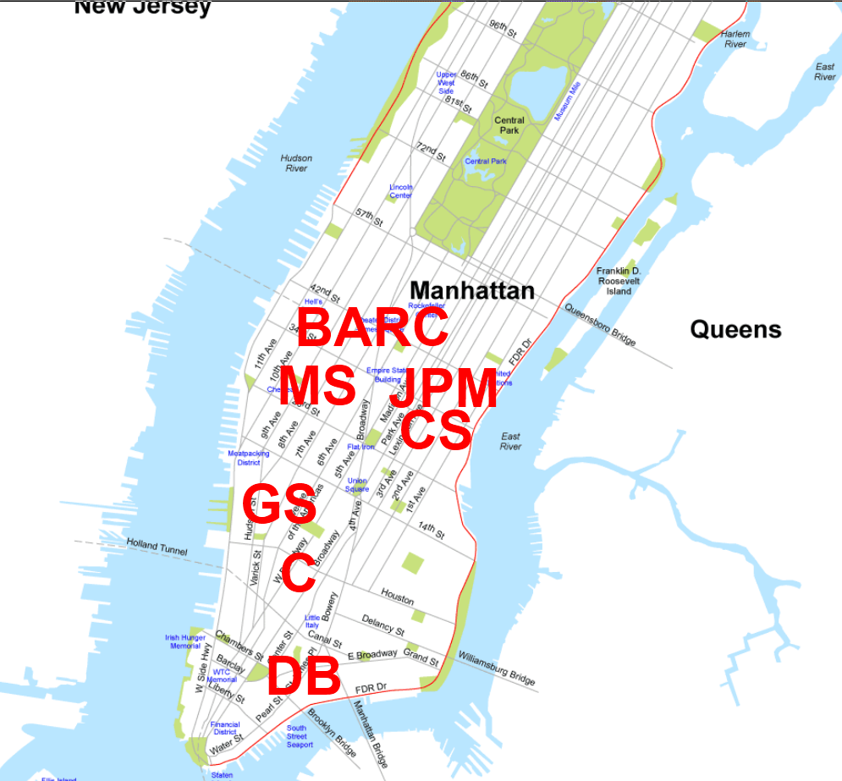

Slide 18
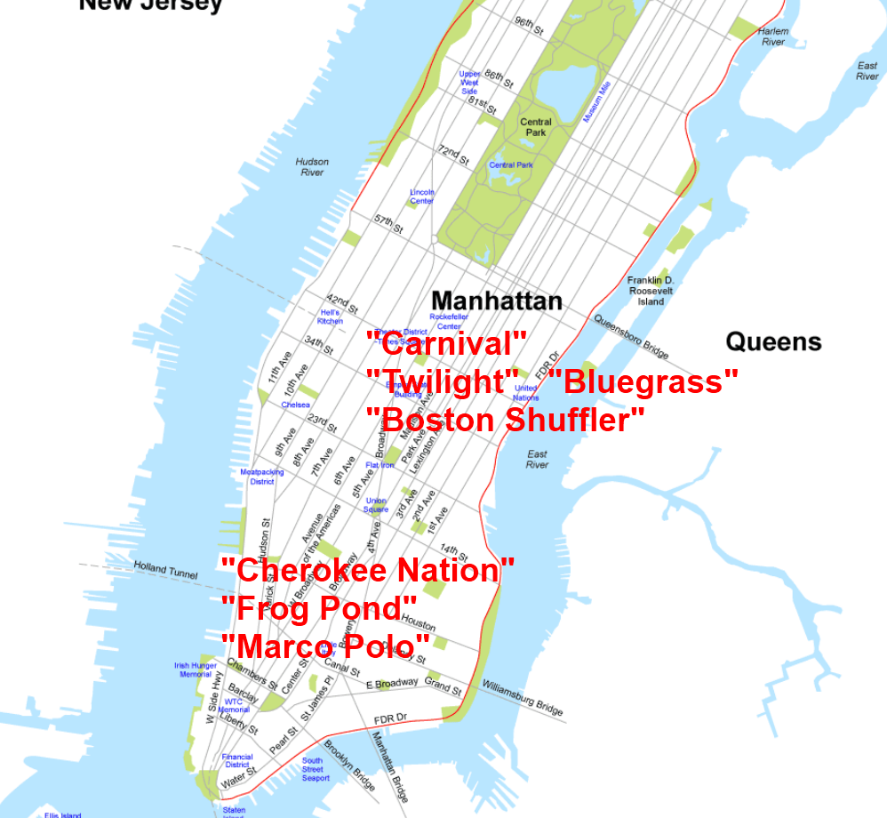
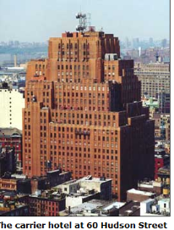

Slide 19
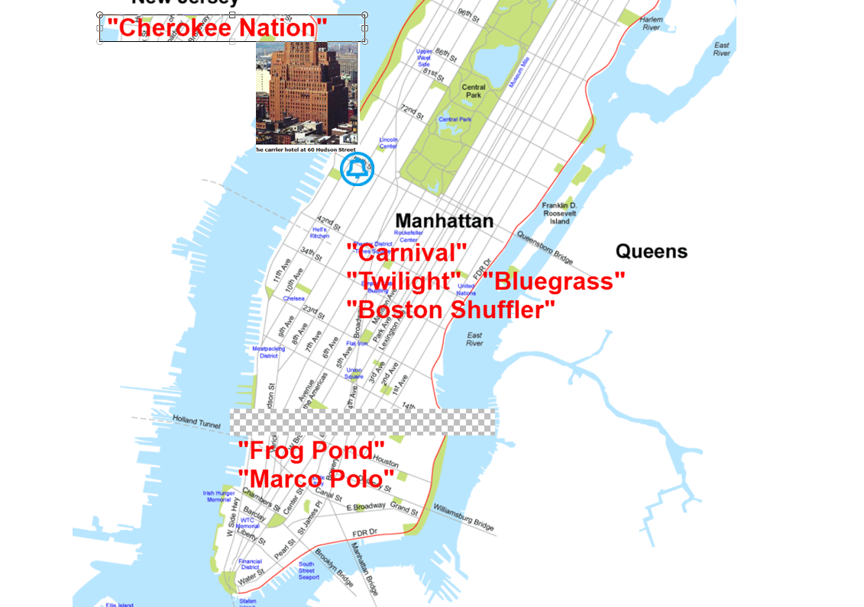

Slide 20
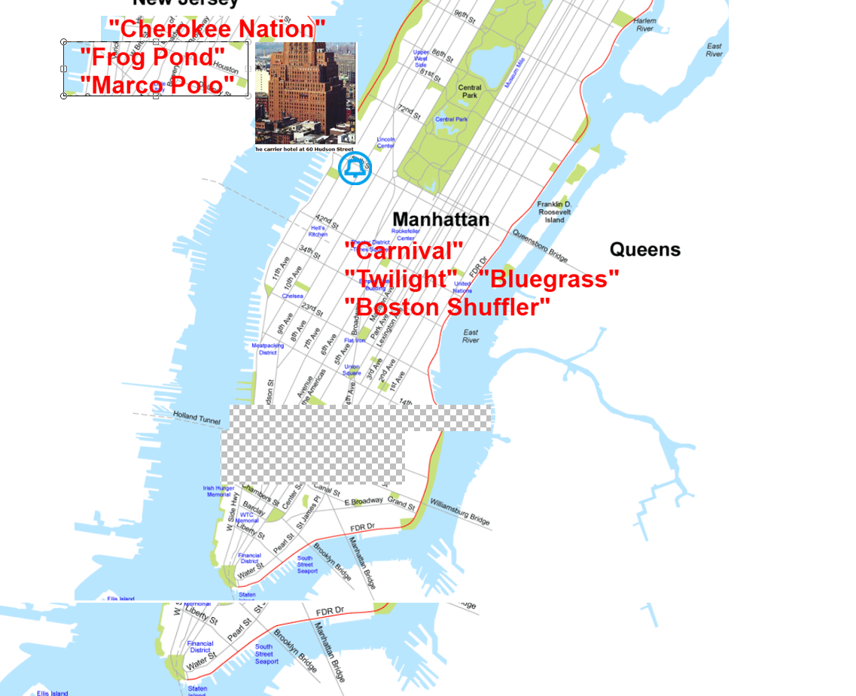

Slide 21
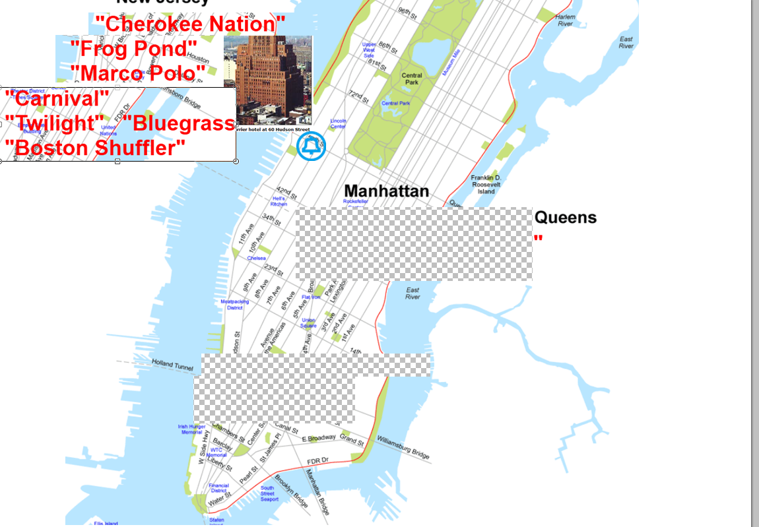

Slide 22
Full story of the legend of the NYC Carrier Hotel … and how it became the place where
“wall street trading algorithms check in … but they don’t check out”
is very compellingly told here:
http://www.ted.com/talks/kevin_slavin_how_algorithms_shape_our_world.html

Slide 23
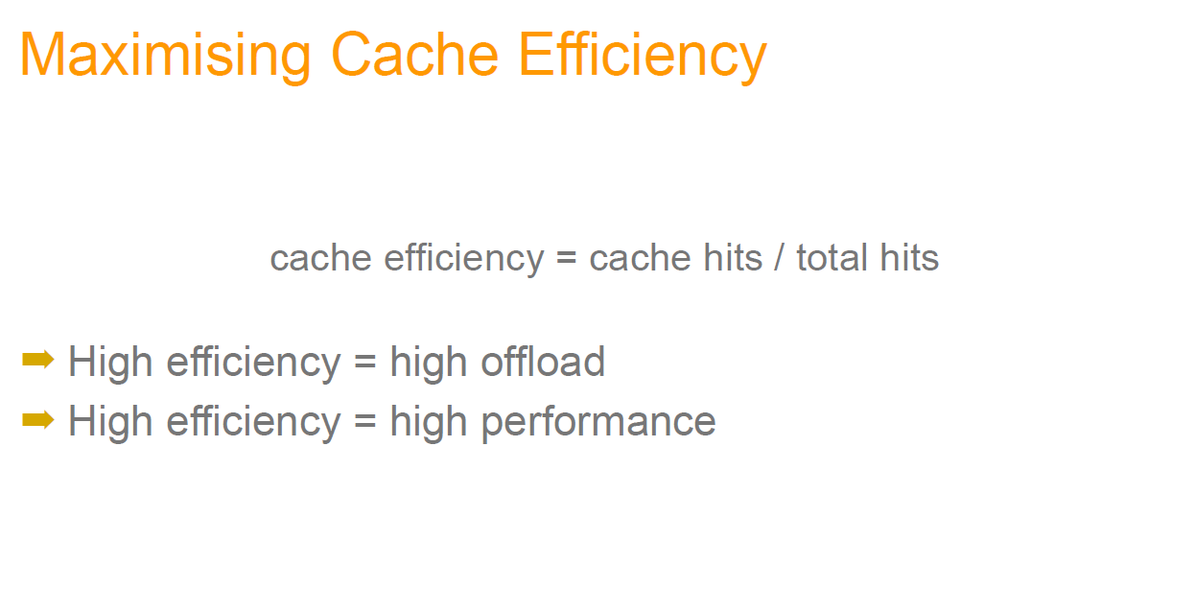
Beyond LL/HF Caching’s Mathematics, Physics and (dramatic) case studies we can sum up the general definition of Caching performance in one simple expression ratio:
How can we best make this happen w/ Java Caching technology?

Slide 26
CAP: The simplest view of simultaneous service guarantee capabilities and tradeoffs.
Abstract Communication Partition
DataNode 1
DataNode 2
1. Allowing 1 or both available nodes to be UPDATED means you lose simultaneous Consistency
2. To guarantee simultaneous Consistency you must make 1 node unAvailable
3. If you want both C & A then all nodes must communicate and synchronize, but then you gain Partition risk (Communication could break).

Slide 27
Ben starts a “Birthday Reminder” service
@t=1 Call Ben … put(“name”,”DOB”);
@t=2 Call Ben … get(‘name”,”DOB”);
//lacks availability … what if 2 calls arrive at same time?
Ben adds ex-wife to answer phones
Call svc … put(“name”,”DOB”);
Call svc … get(“name”,”DOB”);
//lacks consistency … what if call
@t=1 Ben answers = put(“name”,”DOB”)
@t=2 call back … but ..ex-Wife answers … get(“name”,”DOB”) fails?
Ben & ex-Wife add coherency and synchronization protocol
Call svc … put(“name”,”DOB”);
Ben & ex-Wife get in fight …stop talking. //coherency sol’n useless!
Call svc … get(“name”,”DOB”);
//lacks partition tolerance

Slide 29
Protocols for Cache Replacement/Consistency
Belady’s Algorithm (aka Clairvoyant)
LRU
MRU
Random
LFU
LIRRS
CLOCK – FIFO/LIFO/FILO/LILO
Protocols for Cache Partition(Node) Health/Healing
Cardiology Protocol
- Nodes obliged to produce “Heart Beat”
- Central ‘Cardiologist’ consumes HB pulses, treats ‘illness’
Gossip Protocol
- Nodes obliged to produce “rumors” about neighboring nodes
- Central “Gossip columnist” collect rumors, treats ’illness’ based on Gossip credibility policy.

Slide 30
Java Caching API “Join Points” =

Slide 31
Enough of the theory of Caching… on to the standard Java Caching API …
On to JSR-107!
Before JSR-107 all Java Caching vendors provided proprietary APIs
Caching code suffered from vendor lock-in
Just like JDBC solved this problem for the RDBMS community, JSR-107 solves this problem for the JCACHE community
JSR-107 completely open … not hosted on private jcp.org EG forum. Hosted on http://groups.google.com/group/jsr107 public EG forum.

Slide 35
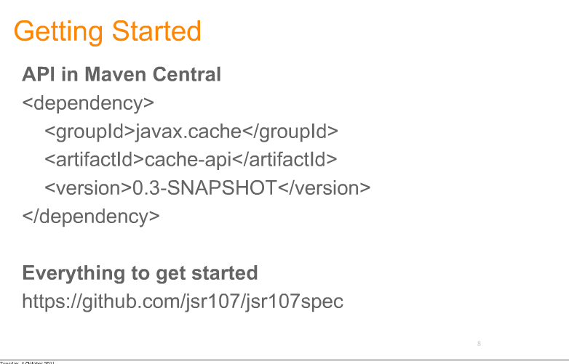

Slide 36
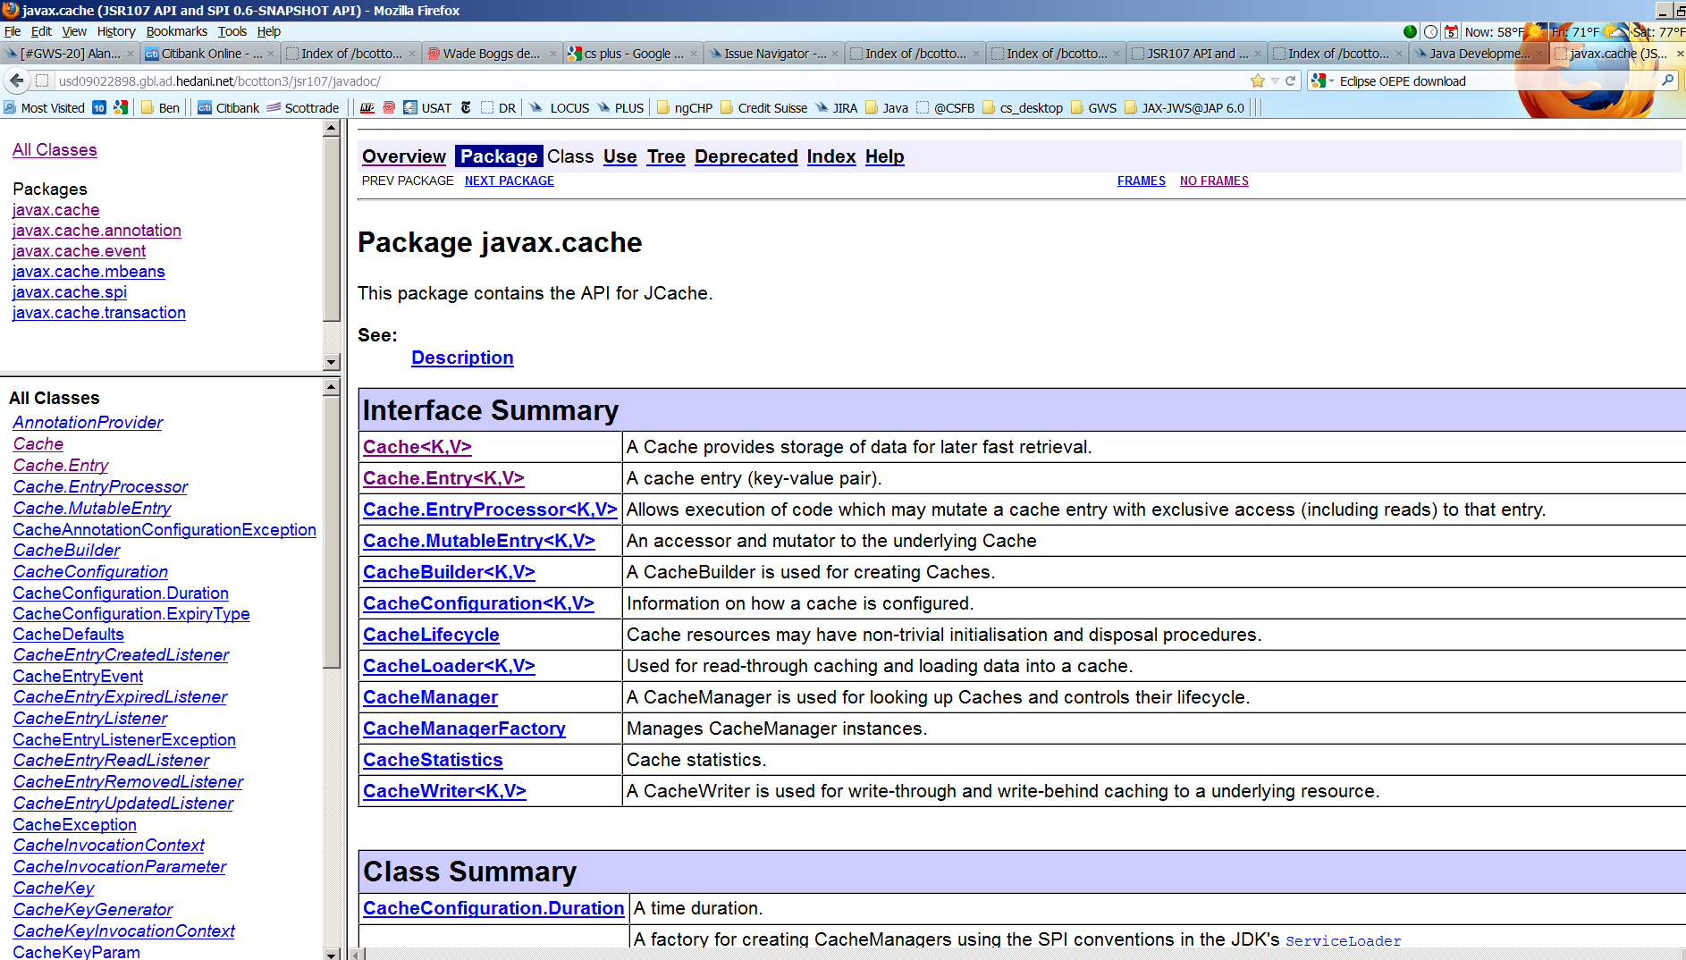
(blank)

Slide 38
A JSR-107 compliant Caching implementation is “Transactional” in 2 important (different) senses:
1. Compound access/mutate operations against a Cache Entry are guaranteed to be EXCLUSIVE and ATOMIC.
(see javax.cache.Cache.EntryProcessor interface)
2. Compound operations against a Cache are guaranteed to preserve Transactional ACID properties.
(see JTA and javax.transaction.UserTransaction interface)

Slide 39
Important to note re: JSR-107 specification of “Transactional” Java Caching …
If a Java Caching provider claims to be “JSR-107 Transactions compliant”, then all of the following transactional isolation levels are guaranteed to be available in the provider’s JSR-107 implementation:
TX_READ_UNCOMMITTED
TX_READ_COMMITTED no ‘Dirty Read’ guaranteed
TX_REPEATABLE_READ ‘Repeatable Read’ assurance guaranteed
TX_SERIALIZABLE no ‘Phantom Read’ guaranteed
In other words, a 100% sound and 100% complete API capability for managing transaction isolation is guaranteed.
CRUCIAL for Capital Markets Java Caching uses cases!!

Slide 40
JSR-107 => all Java Caches now guarantee TX capabilities:
TX_THR_1 JCACHE_ENTRY TX_THR_2
@t=0 utx.begin(); $5 utx.begin();
@t=1 mutate(credit $1) $6
@t=2 $6 val = access() //$6
@t=3 //more processing $6 //more processing
@t=4 utx.rollback() $5
@t=5 $5 utx.commit() //$6 ??
// NOTE: @t=4 DIRTY_READ realized by TX_THR_2 access() @t=2

Slide 41
Can we use JSR-107 API to prevent Dirty Reads?
Of course!!
Just code TX_THR_2 like this
javax.cache.CacheManager cm = javax.cache.Caching.getCacheManager(id);
javax.cache.Cache c = cm.createCacheBuilder(“bank_cache”)
.setTransactionEnabled(
javax.cache.transaction.IsolationLevel.READ_COMMITTED,
javax.cache.transaction.Mode.LOCAL
).build();
javax.transaction.UserTransaction jsr107_utx = new JSR107ProviderJTAUserTransactionImpl(c);
jsr107_utx.begin();
try {
//process
BigDecimal cash = c.get(ACCOUNT_ID); // @t=2 … guaranteed to BLOCK until TX_THR_1 commits/RB
//process more
jsr107_utx.commit();
} catch (Exception e) {
jsr107_utx.rollback();
}
// STILL NEEDED => OPTIMISITIC and PESSIMISTIC block policy (via API) for @t=2 DIRTY_READ

Slide 42
JSR-107 => DIRTY READ prevention
TX_THR_1 JCACHE_ENTRY TX_THR_2
@t=0 utx.begin(); $5 utx.begin();
@t=1 mutate(credit $1) $6
@t=2 $6 val = access() //BLOCK
@t=3 //more processing $6
@t=4 utx.rollback() $5
@t=5 $5 val = access() //$5
// DIRTY READ guaranteed to be PREVENTED
7/9/2013
42

Slide 43
Can we use JSR-107 API to accommodate all TX_ISOLATION tolerances (and intolerances) ?
What about rare transactional use cases that have extreme TX_ISOLATION demands? E.g. Intolerance to PHANTOM_READS? Can JSR-107 accommodate these rare (but important ) uses cases?
Answer = YES!!
What about multiple, dynamic views of the same Cache with different (possibly extreme) TX_ISOLATION demands?
Answer = YES
EG common Bond Portfolio CACHE shared by both RETAIL and INSTITUTIONAL Trading desks
…
trade
HY Credit Portfolio (3,000 bonds)
trade
RETAIL desk
1000s of trades daily
Each trade = few millis to transact
Avg Trade = $5,000 USD
Use JSR-107 TX_READ_COMMITTED
INSTITUTIONAL desk
dozen or so trades daily
Each trade = 4-6 secs to transact
Avg Trade = $10,000,000 USD
PHANTOM_READ intolerant
Use JSR-107 TX_SERIALIZABLE

Slide 49
Fluent Builder Pattern

Slide 56
Questions (?)
Acknowledgment: Much of this PPT was taken from Greg Luck and Cameron Purdy’s JavaOne 2012 presentation on JSR-107 see=
http://www.parleys.com/#st=5&id=3046

