Slide 1
Administration Console
Dashboard
Jboss Web Console
Jboss Admin
JVM
Memory
File system
File system
Max Memory (Mb) 2045
Free memory (Mb) 13
Active Thread 150
Max (Gb) 2045
Free (Gb) 13
Database
Satus Active
CPQ
Last 60 sec
Last 60 min
Last 24 hours
Status Active
New connection Enable
Sessions
Sessions Historic
Disable
Max
Statistics
Configurator
Last 60 sec
Last 60 min
Last 24 hours
Status Inactive
New connection Disable
Sessions
Sessions Historic
Reason: db problem / Jboss pb
Enable
Statistics
Catalog
Last 60 sec
Last 60 min
Last 24 hours
Sessions
Sessions Historic
Status Active
New connection Disable
Enable
Statistics
Notes:
A faire avec le framework du designer
Status = active / inactive
New connection = enabled / disabled
Histogramme : mode salesforce
Statistics : V2

Slide 2
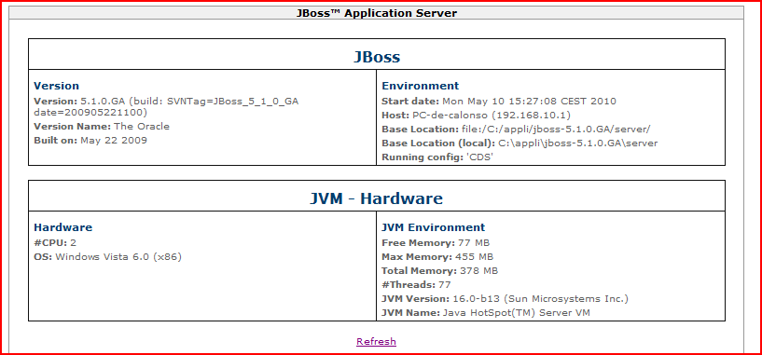
Administration Console
Dashboard
Jboss Web Console
Jboss Admin

Slide 3
Administration Console
Dashboard
Jboss Web Console
Jboss Admin

