Slide 1
e-Science Central
Simon Woodman
Hugo Hiden
Derek Mortimer

Slide 2
What is e-SC
An environment to store, manage and process data
A platform that can operate in a number of different locations
  Single computer
  Cluster of local servers
  On a cloud provider (Amazon and MS)
An expandable system
  API is provided to connect other software
  Code can be added as workflow blocks
A platform for our academic research
  Scalability, data management, cloud computing, medical data management

Slide 3
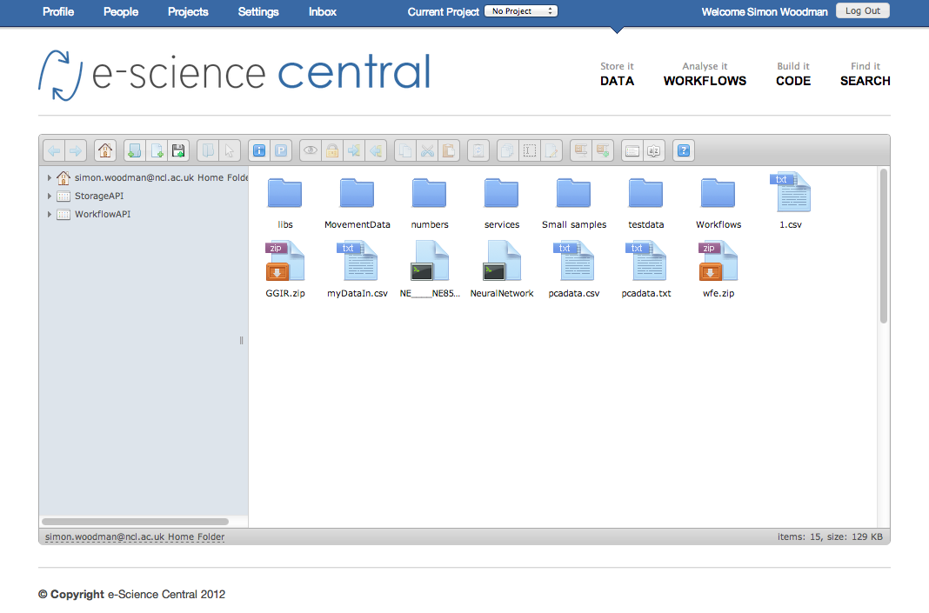
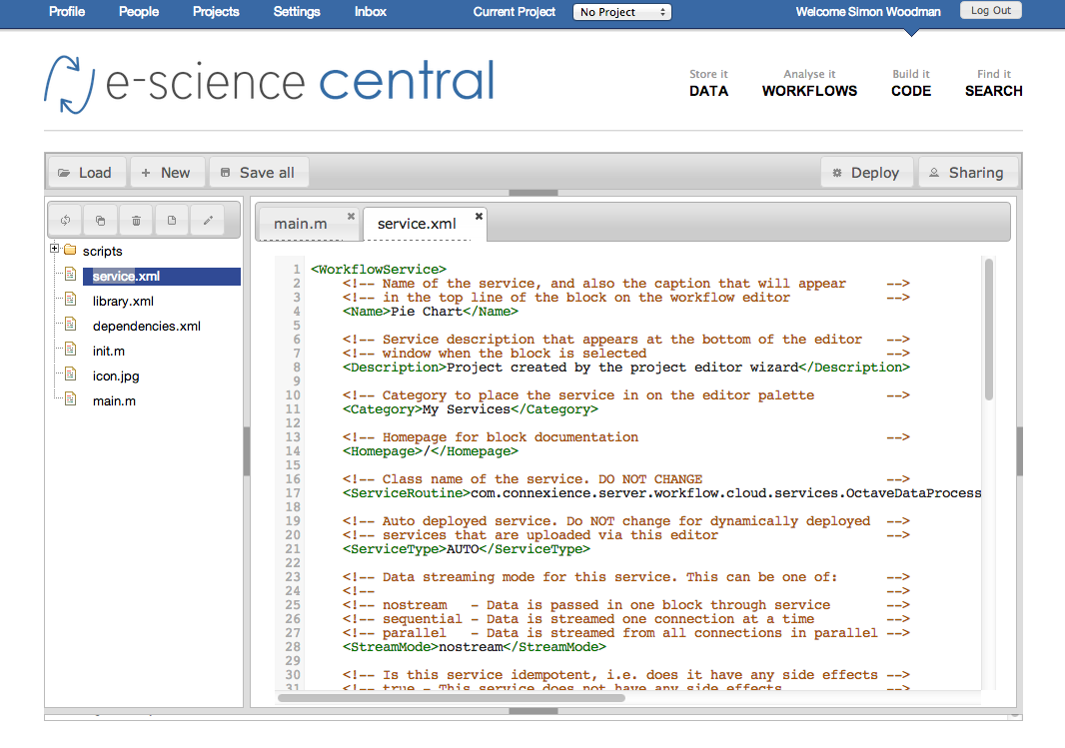
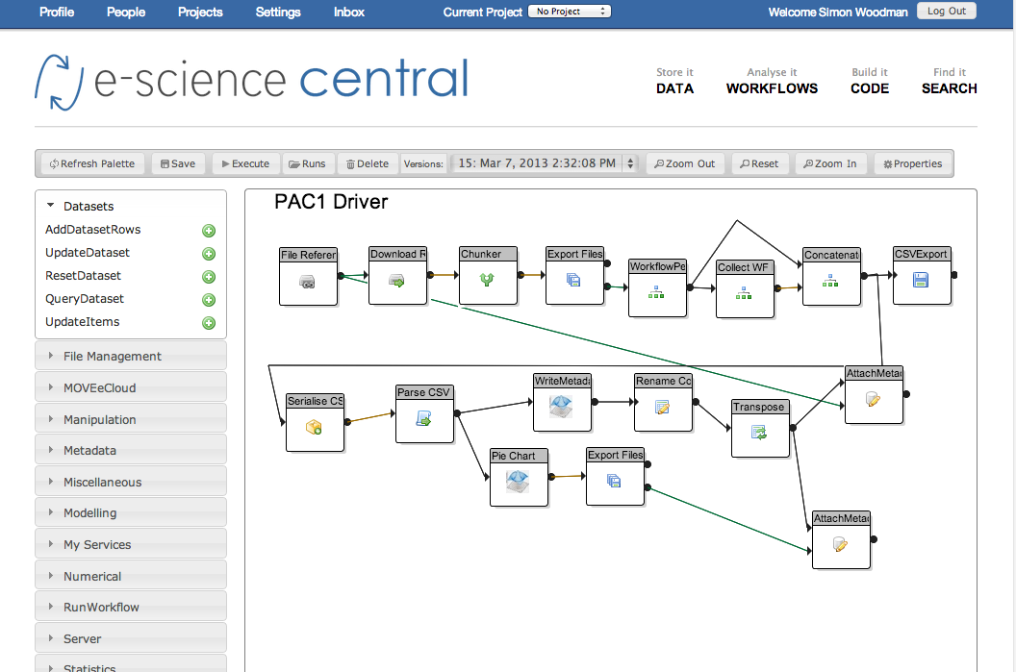
e-Science Central
Platform for cloud based data analysis
Azure
EC2
On Premise
Java
R
Octave
Javascript

Slide 8
What are workflows
Workflows are a way of graphically manipulating data
They tend to have three parts:
There are more complex structures, but this pattern is typical
Workflows are “drawn” and then executed
Load data
Process data
Save results

Slide 9
Motivation for workflows
Spreadsheets become unwieldy quickly
  Emphasise data over process
  Hard to see what has been done with data
    Not obvious what calculations have been done
    Hard to extract some of the the calculations and re-use them
  Require everything to be done using the spreadsheets tools
    May not include everything needed
Workflows attempt to mitigate some of this
Integrate different languages
  Java, R, Octave, Javascript

Slide 10
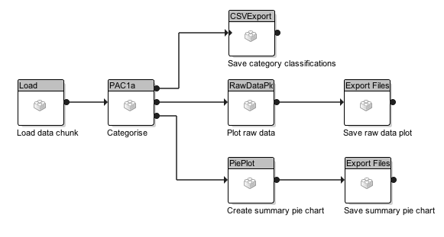
Anatomy of a workflow
Typical simple workflow – follows the standard pattern
Store results
Process data
Load data

Slide 11
Workflow Blocks
Workflow blocks are units of code that execute as part of a workflow
  They have a defined structure
  Can be configured using properties
    Strings, numbers, booleans, file references, lists etc
  Can act on local files, data-sets, name-value pairs, serialized Java objects and links to files stored in e-SC
  Need to be able to operate without user interaction

Slide 12
Execution of Workflow Blocks
Blocks execute as part of a workflow
  The code is transferred to the machine executing the workflow
  The block code is unpacked on the workflow machine
  Dependencies are also downloaded and unpacked
  The block is then executed in the workflow working directory
    Properties are assigned
    Initialisation code is executed
    The block main code is then executed (potentially multiple times)
    Termination code is then executed

Slide 13
Accessing the e-SC Server
Java and JavaScript blocks have access to an API that provides limited access to information held in the e-SC server
  Upload / download files
  Attach / read metadata
  Update / query datasets
  Execute additional workflows
Actions performed using the API are carried out as the same user executing the workflow

Slide 14
Case Studies

Slide 15
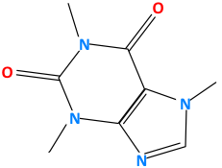


QSAR - The Problem
What are the properties of this molecule?
Toxicity
Biological Activity
Solubility
Perform experiments
Time consuming
Expensive
Ethical constraints

Slide 16
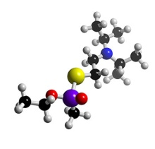
QSAR
QSAR
Quantitative Structure Activity Relationship
f(
)
Activity ≈
More accurately, Activity related to a quantifiable structural attribute
Activity ≈ f( logP, number of atoms, shape....)
Currently > 3,000 recognised attributes
http://www.qsarworld.com/

Slide 17
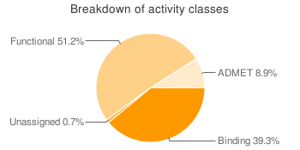
The Alternative to Experiments
Predict likely properties based on similar molecules
CHEMBL Database:
data on 622,824 compounds,
collected from 33,956 publications
WOMBAT Database:
data on 251,560 structures,
for over 1,966 targets
WOMBAT-PK Database:
data on 1230 compounds,
for over 13,000 clinical measurements
All these databases contain structure information and numerical activity data
What is the relationship between structure and activity?

Slide 18
Branching Workflows
Partition training & test data
Random split
80:20 split
Calculate descriptors
Java CDK descriptors
C++ CDL descriptors
Select descriptors
Correlation analysis
Genetic algorithms
Random selection
Build model
Linear regression
Neural Network
Partial Least Squares
Classification Trees
Add to database

Slide 20
Results
250k models
  Linear Regression
  PLS
  RPartitioning
  Neural Net
460K workflow executions
4.4M service calls
QSAR Explorer
  Browse
  Search
  Get Predictions

Slide 21
Scalability: Large Scale QSAR
480 datasets sequential time: 11 days
 | 100 Nodes | 200 Nodes
Response Time | 3hr 19mins | 1hr 50mins
Speedup | 94x | 156x
Efficiency | 94% | 78%
Cost | $55.68 | $51.84

Slide 22
Performance is great but …
Drug Development requires us to capture the data and the process

Slide 23
Provenance/Audit Requirements
How was data generated?
  What algorithm?
  What version?
Are these results reproducible?
How have bugs manifested?
  Which data affected
  How do we regenerate affected data?
Performance Characteristics
How do we deal with new data?
Notes:
Important for drug discovery due to traceability requirements

Slide 24
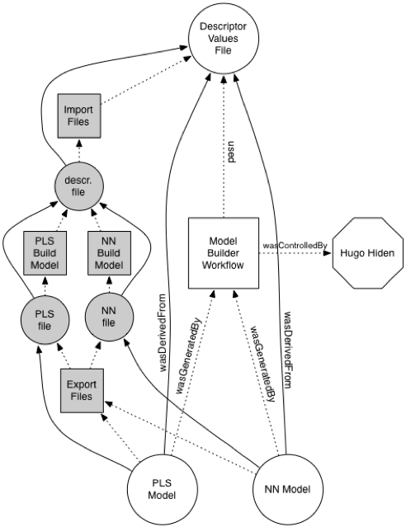
Provenance Model
Based on OPM
  Processes, Artifacts, Agents
Directed Graph
Multiple views of provenance
  Dependent on security privileges

Slide 25
Storing Provenance
Neo4j
  Open Source Graph Database
  Nodes/Relationships + properties
  Querying/traversing
Access
  Java lib for OPM
  e-SC library built on top of OPM lib
  REST interface
Options for HA and Sharding for performance
Notes:
Natural fit for storing provenance as it’s a graph to start with

Slide 27
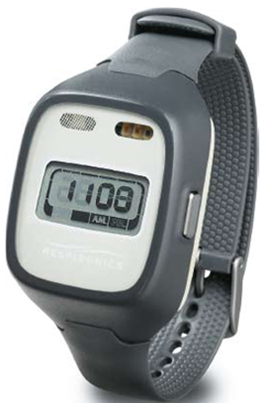
MOVEeCloud Project
Investigating the links between physical activity and common diseases – type 2 diabetes, cardiovascular disease,…
Wrist accelerometers worn over 1 week period
Measures movement at 100Hz in three axes
Processing ideal for Azure
  Bursty data processing as new data gathered
  Embarrassingly parallel
  Large datasets
Notes:
Large datasets need smart moving of data around – HDFS? otherwise hit the limit on storage account b/w

Slide 28
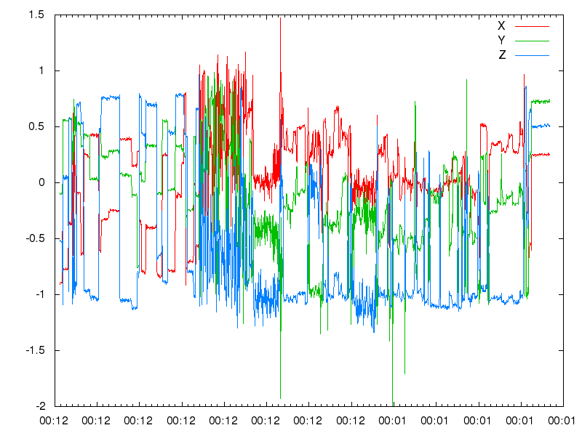
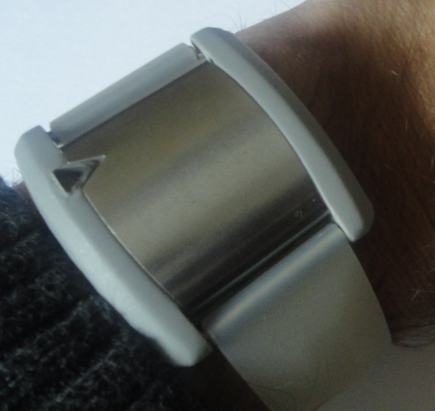
MOVEeCloud Process
Analysis and
Classification
R, Java, Octave
Sleep
Walking
Sedentary
Activity
Sedentary
Clinician’s Report
Patient Interventions
Methodology Section for Papers

Slide 29

Data Sizes
100 samples / second
100 rows
3600 seconds / hour
360,000 rows
24 hours / day
8,640,000 rows
7 days / study
60,480,000 rows
/ patient / visit
Cohort size of 800 patients and multiple visits

Slide 30
Working with larger data sets
As we add more workflow engines server load increases
  One server can cope 200 engines if files are small
This is not the case with movement data
  Only support 4 engines
Increase the bandwidth to the engines
  Clustering appserver /database?

Slide 31
HDFS
Implemented prior to Native HDFS on Azure
Easy to integrate with e-sc
  Java system just requires libraries included in e-sc
Distributed store where bandwidth increases with number of machines
  Bits of data spread around lots of machines
Concept of data location
  Potential to route workflows to execute as close as possible to storage
Other applications also also built on top of HDFS
  Open TSDB to store timeseries for movement data
Notes:
Single POF
Not great for small files or 1M+ files
Instances can terminate resulting in loss of data

Slide 32
Initial Results
For a single data set processing went from 60 to 16 minutes using 4 workflow engines running HDFS
4 engines the limit for one e-sc server
  Main server hit 100% CPU delivering data
  No further improvements with more engines
Using HDFS CPU was consistently below 5%
  More like our earlier scalability results
Once data had been chunked processing was the same for each chunk
The improvement lay entirely in staging and uploading results

Slide 33
Upcoming Challenges
Process Newcastle 85+ and Whitehall Study Data
  6TB
New TSB Project with RedHat and Arjuna
  e-Science Central onto OpenShift
  Integrate Arjuna Agility
  Analyse traffic flow data from Newcastle

Slide 34
Demo

